Slide 1

Beyond Encoding: Refining and Launching Text-Based Digital Humanities Projects
Session 1: Course Introduction

Slide 2

Today’s Agenda
Course Introduction and Overview
Part 1: Project Planning and Project Management
Part 2: Doing things with (XML) data
Break
Project Lifecycles
Software Setup

Slide 3

Introductions
Name
Location/affiliation/department
Project/point of connection
What you’re hoping to learn in this course

Slide 4

Course Assumptions
Data
A text-oriented approach to data
Data which is well-suited to XML structures
Project Management
A digital project in relatively early stages (conceptual or in early implementation)
A digital project that hopes to grow in scope and scale, and which will benefit from complex data

Slide 5

Course Goals
Project Planning and Management
Doing things with (XML) Data

Slide 6

Project Planning and Management
Project lifecycles
Iterative/expandable design
Project tools
Editorial and design principles
Project documentation
Scaling up
Winding down

Slide 7
Doing things with (XML) Data
Data management: Regex and Git
Good data: Metadata standards, controlled vocabularies, linked open data
Constraining data: ODD and Schematron
Transforming data: XSLT
Navigating data: Xpath
Querying data: XQuery

Slide 8

Break Time (10 minutes)
This Photo by Unknown Author is licensed under CC BY-ND

Slide 9

Project Lifecycles

Slide 10
Iterative Structure
Materials
Goals
What are your/your team's goals for the project?
Users
Who are you making this project for?
Technology
What technologies will your project rely on?
Outcomes
Publications
What are the core components of your digital project?
Data, images, texts, recordings, etc.
Resources
Time
Money
People
Long term goals ("finished" project) vs. short term goals (minimum viable product)
How do you expect them to use it?
What do they need to be able to use the project?
Who else might use the project?
What tools already exist?
What will you need to learn?
What will you rely on others for?
Grants
Classes
Ending a project

Slide 11
Materials
Beginning state: transcription, OCR, digitization
Who performs this labor? How much does it cost (time, money)?
Copyright: what laws and permissions govern the materials in their current state? What constitutes fair use? What kinds of copyright can/should you place on your project?
How much digital space do these materials take up? What kinds of hosting are required for them?
How much of your materials do you need to get started?

Slide 12
Resources
Time
Money
People
External:
Conferences
Grant funding schedules
Promotion and tenure clocks
Internal
How much time is needed for each element of the project?
Where:
Grants
University funding
For what?
Labor
Materials
Tools & Technology
Hosting
Project staff
Contributors
Students
Collaborators
Advisors

Slide 13
Goals
Short-term
Long-term
What do you need? Why do you need it?
Proof-of-concept, wireframing, prototyping
Beta testing, user experience testing
Minimum viable product
Functional product
Finished product
Sunsetting the project

Slide 14
Users
Who?
What do they need?
Scholars
Students
What level?
Public
Who?
Context
Accessibility
Data vs. display vs. explanation
What responsibilities do you have to your data?
Copyright?
Sensitive information

Slide 15
Technology
Be careful of “reinventing the wheel”
What tools already exist, what needs to be created?
How much of the technical expertise do you need to have personally?
To what extent is learning the technology one of the goals of your project?
Who maintains it? For how long? How much maintenance does it need?

Slide 16
Outcomes
Finished project
Presentations (Field specific, DH specific)
Publications (Research outcomes, Research methods)
Classes (DH skills, Teaching with the content)
Grants
Peer Review

Slide 17

Sustainability
From the Endings Project:
Data (open standards, version control, consistent)
Documentation (comprehensive, clear)
Processing (valid, integrated, contingent)
Products (common standards, static, accessible data, redundant, graceful failure)
Release Management (periodic, planned, stable, versioned, persistent)

Slide 18

Installing Oxygen
If you have not already done so, download the appropriate version of Oxygen XML Editor from https://www.oxygenxml.com/xml_editor/download_oxygenxml_editor.html
Install Oxygen.
When prompted, provide the license key emailed to you before class.

Slide 19

Oxygen Tips and Tricks
Night mode: Options → Preferences → Appearance
Under “Appearance” you can also adjust font and font size, text colors, etc.
Automatic text wrapping: Options → Preferences → Editor → Edit Modes → Text → check “Line wrap”
To wrap a highlighted selection in a tag:
Ctrl + e (on Windows), Cmd + e (on Mac)

Slide 20
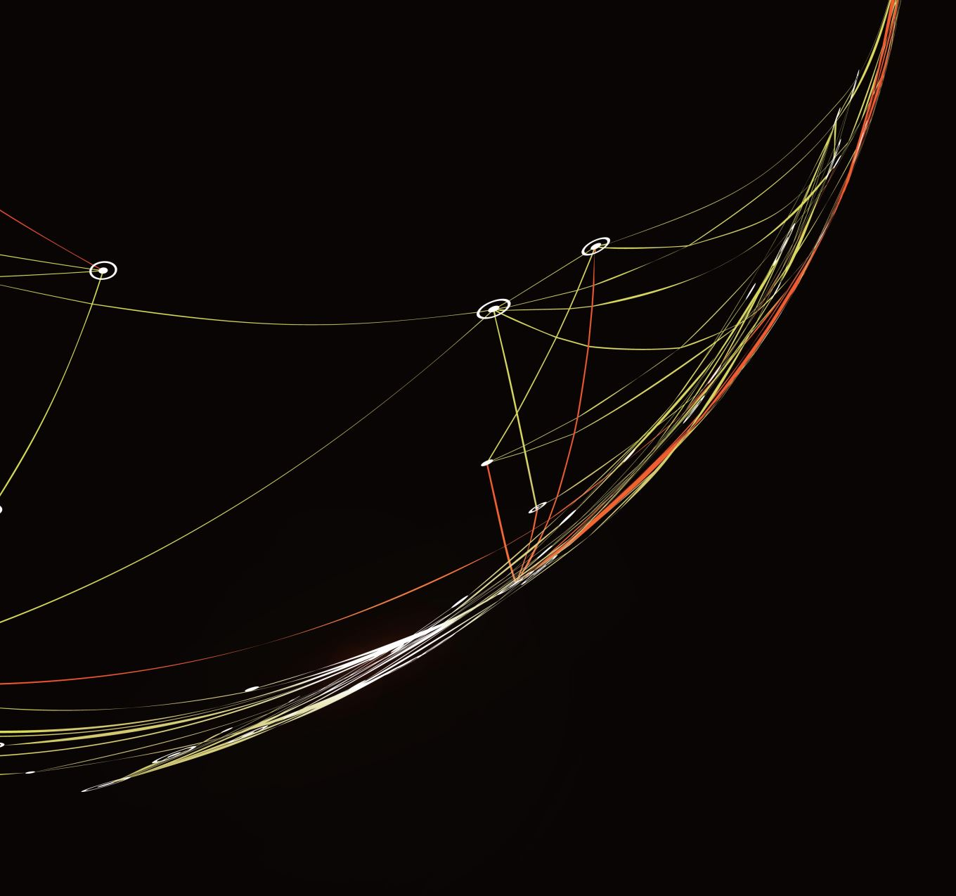
GitHub
Sign up for an account at https://github.com/
Download GitHub Desktop from https://desktop.github.com/

Slide 21
Next Time
Goals, Principles, and Tools
Readings posted on Course Syllabus (programming4humanists.tamu.edu/syllabus-spring-2023)
Optional Homework:
Complete Yale DH Lab’s “Lean Canvas” and upload to course Google Drive.

